Slide 1

MSPM’S
DEOGIRI INSTITUTE OF ENGINEERING AND MANAGEMENT STUDIES SEMINAR (REVIEW-2)
Presentation on:
Automatic and Real- time Pothole Detection And Trafﬁc Monitoring System using Smartphone Technology
Submitted By:
Nikita Muthal(36119)
Siddhi Gaud(36128)
Class: TE-2
Guide: Prof. P.H. Durole

Slide 2
Contents
Abstract
❏ Introduction
❏ Methodology
➔ Software System Development Methodology
❏ Features
❏ Proposed System Model
❏ Conclusion

Slide 3
ABSTRACT
Technology , more specifically, mobile phone technology has evolved to enable miniature devices the capability of containing powerful sensors.
The functionalities of these sensors, such as accelerometers, present in smart phones is what this study exploits to develop a system capable of automatically detecting potholes in real-time and monitoring road traffic conditions.
Machine learning techniques; Support vector machines based on K-means clustering, are applied to the data obtained from such sensors to estimate road/traffic conditions.
Keywords:
Road condition, traffic, potholes, real-time, machine learning, mobile, sensors, visualization

Slide 4
INTRODUCTION
Detection of potholes and traffic monitoring is a problem widely studied in recent times, and the approaches often employ the usage of dedicated sensors such as GPS, accelerometers, and traffic cameras.
Thus, the smart phone based pothole detection and trafﬁc estimation methods obviate the need for specialized hardware installed in vehicles or on the roadside. Being crowd-sourced - using distributed participatory data collection - the approach has the advantage of high scalability considering that the number of smart phone users is growing quite rapidly.
Automated embedded sensing systems, including smart phones,generally, have two classes of sensors to be used for pothole detection: microphone and accelerometers. This study employs accelerometer data processing for pothole detection and traffic monitoring.

Slide 5
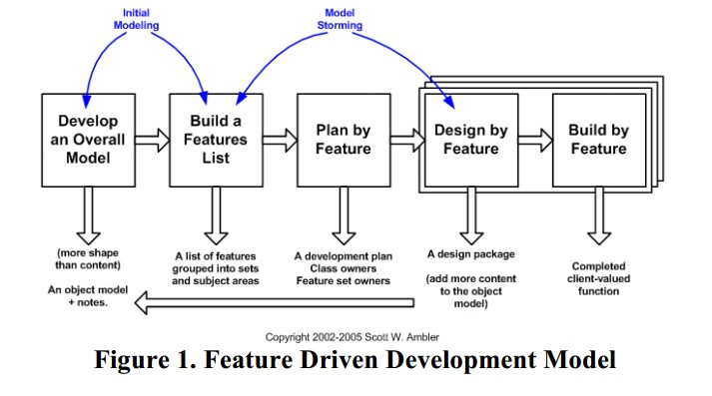
METHODOLOGY

Slide 6
The Software development approach used in the research was the Feature driven development (FDD), which is a client-centric, architecture-centric, and pragmatic software process. Features, as the name implies, are an important aspect of FDD. A feature is a small, client-valued function expressed in the form <action><result><object>, and the various features of the proposed system are highlighted and discussed in the following section.

Slide 7
Analysis of the Various Modules Involved
Sensing Module
The Sensing module is central to the entire system, as its output is what the rest of the system acts on.
This module is responsible for getting the needed parameters from the various sensors being used in the smart phone by the system such as the GPS coordinates from the GPS, the 3-axis acceleration values from the accelerometer.
The magnetic vector from the magnetometer, Network information from radio sensors.
The module is also for triggered sensing where the high power sensors are triggered only when the low power sensors needs to be complemented or when needed.

Slide 8
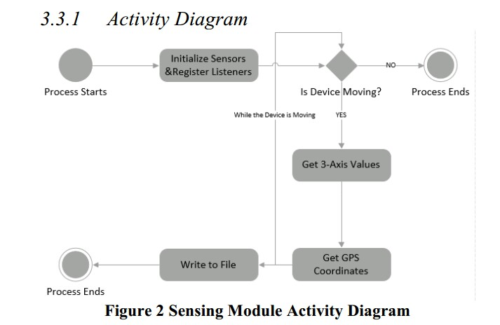

Slide 9
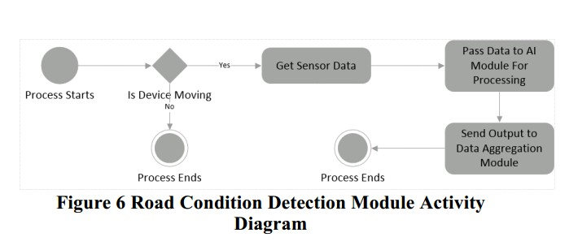
Road Condition Detection Module
The road condition detection module is where the actual prediction of the vehicle state is performed based on the real time sensor information that is passed to the learning module. The module is also responsible for providing input for the data aggregation module where all the data is stored, and works with the sensing module to enable geo-spatial information attached to the data.

Slide 10
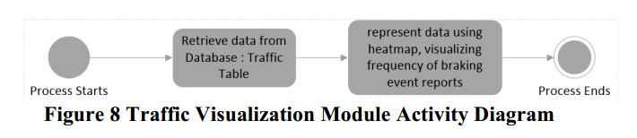
Traffic Visualization Module
Traffic Information Module Similar to the visualization module, the traffic information module gets data relating to traffic information (braking event data) from the road condition detection module and provides the user with information on real-time traffic using a heat map visualization tool on the web app. The module also exposes an interface using REST for other applications to consume the data.

Slide 11
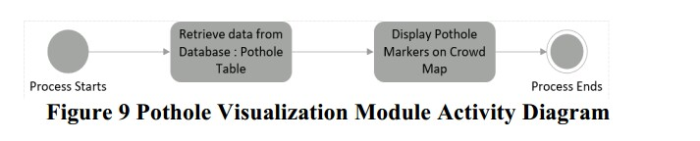
Pothole Visualization Module
The pothole prevention module is responsible for deriving value for the user that is, using the aggregated road condition data to visualize the state of road networks the user is interested in. This module controls the crowd map on the mobile and web applications using pothole data, and provides an interface for other exposing the data to other developers as well.

Slide 12
Conclusion
This project describes and implements a real-time pothole detection and traffic monitoring system, and has been able to harness Smartphone sensors to solve a global challenge, apply Machine learning to a real world problem and develop a scalable, reliable system driven by the power of crowd sourcing.
The challenge embedded in transportation as detailed in the introduction leading to this research, has been shown to be significant.
However as technology advances, and penetration rises, such challenges are solvable with easily accessible tools as shown with the development of this system.

Slide 13
Thank you!

